Slide 1
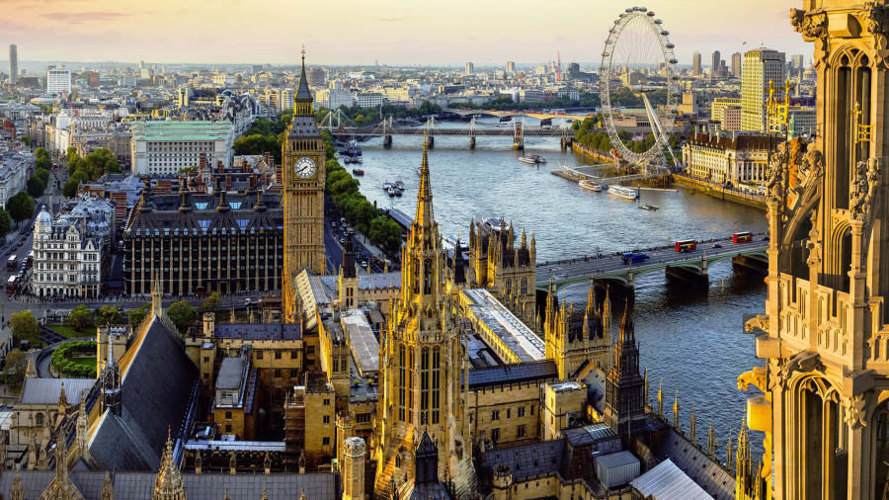
London Residential 20th May – 24th May 2024

Slide 2
Staff
Mrs Walsh
Mrs James

Slide 3
Transport
CMD Travel Hereford.
Private hire of the coach.
We may have to walk from the coach drop off point to the hostel so please ensure your child has one bag which they are able to carry.

Slide 4
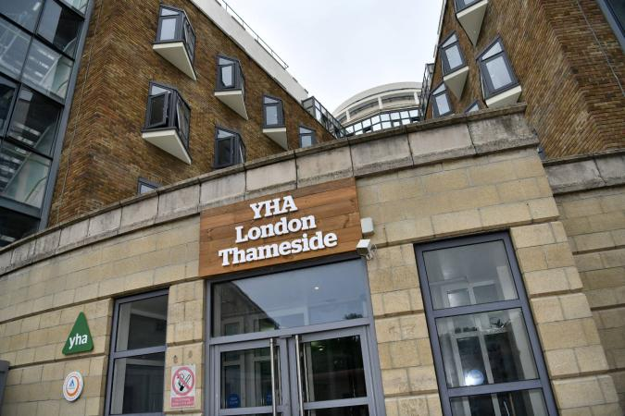
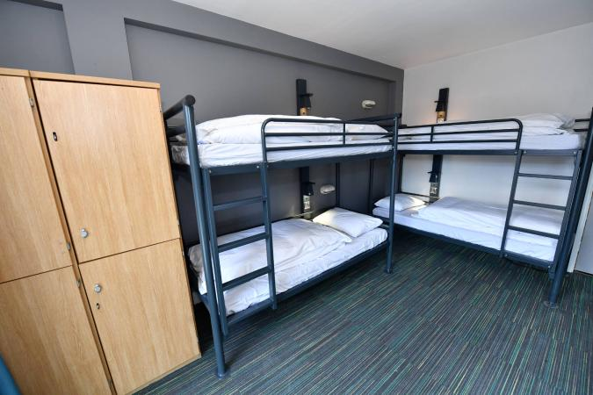
Accommodation
London Thameside YHA
Children in en-suite rooms which range from 4 to 6 beds.
Staff rooms are located next to the children’s rooms.

Slide 5
Meals
The hostel will provide the children with a packed lunch for Tuesday-Friday. Please provide your children with a packed lunch for the Monday in disposable packaging.
The children will choose their sandwich filling in advance.
Meal options will also be chosen in advance.

Slide 6
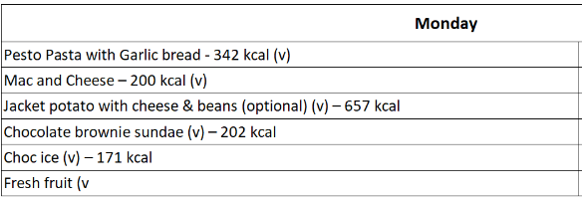
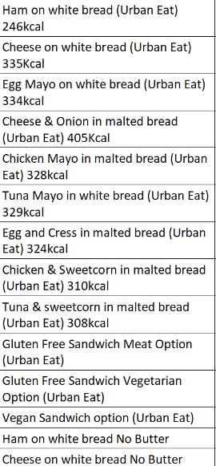
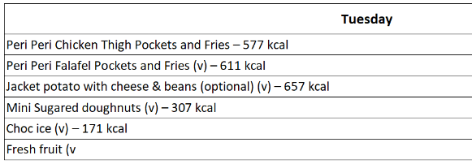
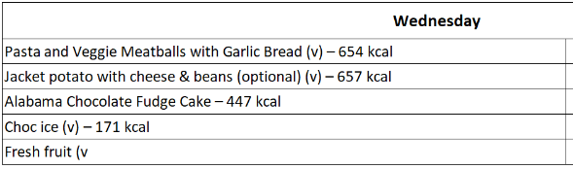
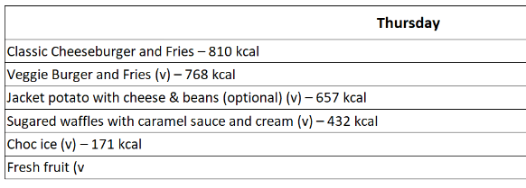
Meals
Packed Lunches

Slide 7
London 2024
Suggested kit list
Please make sure all items on the list are clearly labelled. All bed linen and towels are provided. When packing please try to bear in mind the weather forecast and adjust your clothing accordingly. In addition, children must be able to carry their own luggage.
Packed lunch for Monday please provide this in disposable packaging (not lunchboxes).
Clothing – several complete changes of clothes, including warm hoodies/sweatshirts, jeans or trousers- 2 pairs minimum, shorts, t-shirts, and enough socks and underwear for every day.
Smart / casual clothing for our trip to the Houses of Parliament and the theatre.
Waterproof coat with hood.
Sensible walking shoes / trainers.
Wash bag with toothbrush, toothpaste, shampoo / shower gel, comb and/or brush, roll-on deodorant, tissues. Please don’t bring aerosols as some people who have asthma are affected by them.
Night wear / pyjamas.
Towels are provided but you are welcome to bring one of your own.
Shoulder bag/backpack to hold lunch etc.
Clearly named plastic drinks bottle.
A book or books, a cuddly toy and a small quiet game such as cards.
Some black plastic bin liners for dirty washing.
Lip balm, sun cream or lotion.
No mobile phones.
iPods, mp3 players and cameras can be brought for the journey to and from London at owners’ risk. Please make sure that these devices do not have WiFi enabled.
All medicine, including travel sickness tablets, to be handed to Mrs Walsh.
A sensible amount of sweets.

Slide 8
Spending money
Most places in London, since the pandemic, are now not taking cash.
Last year, the pupils brought pre-paid cards instead of cash. There are numerous ones online (e.g. Go Henry), but all have an annual subscription. There are also Mastercard gift cards (like credit cards) that can be used anywhere. These can be purchased in most supermarkets.
When deciding on spending money we are mindful of additional costs to parents, so we do say £5.00 per day which equates to £25.

Slide 9
Itinerary
Monday 20th May
7:30am Children arrive at school
8.00am Depart School
11.30am Arrive at Warner Brothers Studio
12.30pm Art and Design workshop
1.30pm Tour of the Warner Brothers Studio
5.30pm Arrive at YHA Thameside
6.30pm Dinner
7.15pm Evening walk around the local area

Slide 10
Itinerary
Tuesday 21st May
10.00am House of Parliament Democratic Access Tour – Group 1
10.10am House of Parliament Democratic Access Tour – Group 2
10.20am House of Parliament Democratic Access Tour – Group 3
12.00pm Downing Street and Horse Guards
12.30pm Lunch in St. James Park
1.00pm Buckingham Palace
2.00pm The Natural History Museum
6.00pm Dinner
7.30pm Hollywood Bowl

Slide 11
Itinerary
Wednesday 22nd May
10.00am Science Museum
1.15pm Lunch in Hyde Park
3.45pm River Cruise
5.15pm London Eye
6.30pm Dinner
7.15pm Greenwich Park

Slide 12
Itinerary
Thursday 23rd May
10.00am The Tower of London
1.00pm Lunch
2.30pm HMS Belfast
5.00pm Dinner
7.00pm Mrs Doubtfire at the Shaftesbury Theatre

Slide 13
Itinerary
Friday 24th May
10.00am Madame Tussauds
12.30pm Lunch
1.30pm Depart London
6.00pm ETA back at School

Slide 14
To do:
If anything changes regarding medication, please fill in medication form and hand to Mrs Walsh before departure.
Medication labelled to Mrs Walsh.

Slide 15

Thank you for your time. Any questions?

